Slide 1

Estimating Adaptive Landscape from Genomic Data in the Presence of Strong Genetic Linkage
Igor Rouzine
Group of population genetics and virology
Sechenov Institute of Evolutionary Physiology
and Biochemistry
RSF grant 24-24-00529
igor.rouzine@iephb.ru

Slide 2
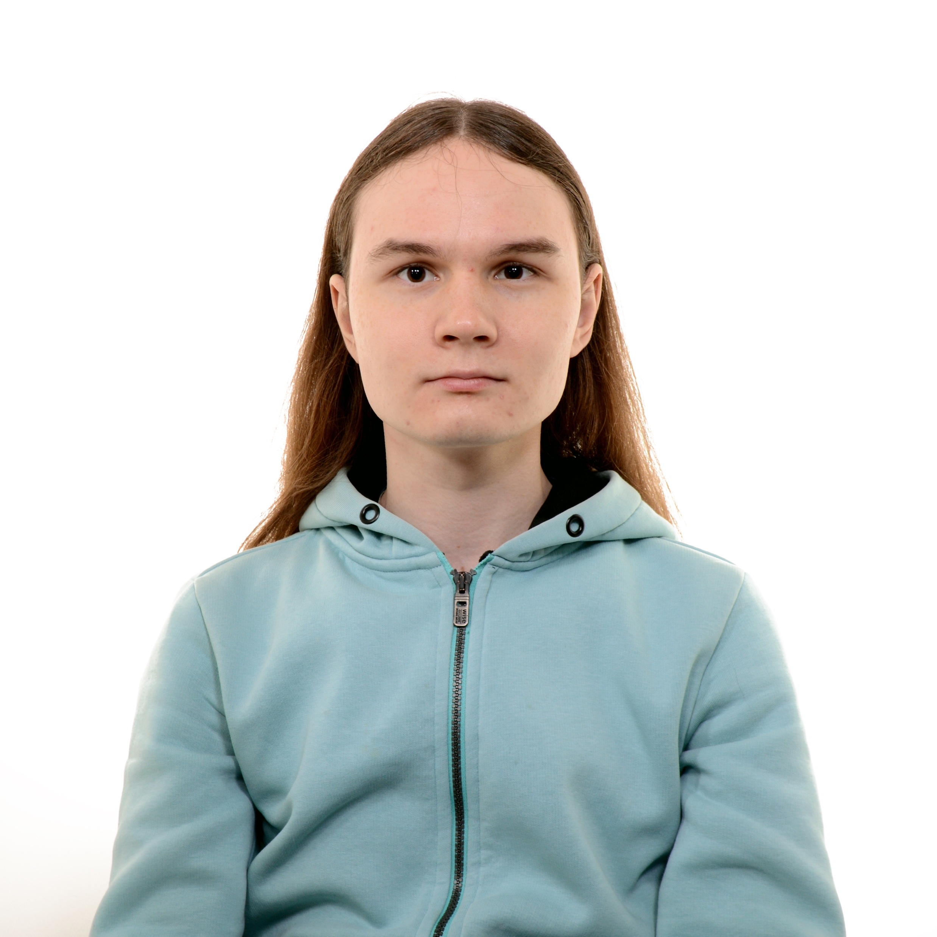
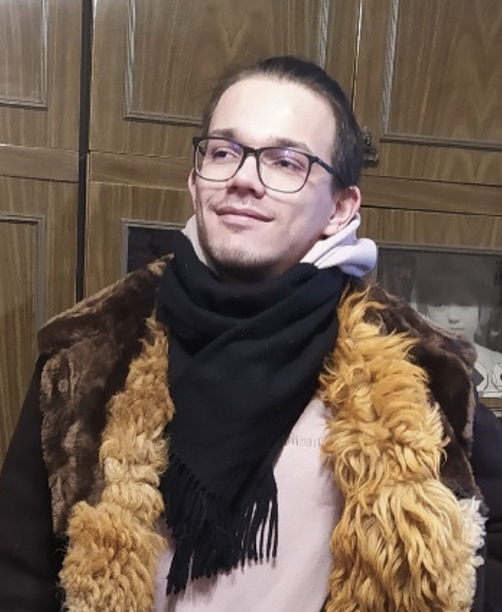
interns who did the work
Igor V Likhachev
Sergey V Lagunov

Slide 3
Estimating the fitness effect of mutations in E. Coli
Sergey Lagunov

Slide 4
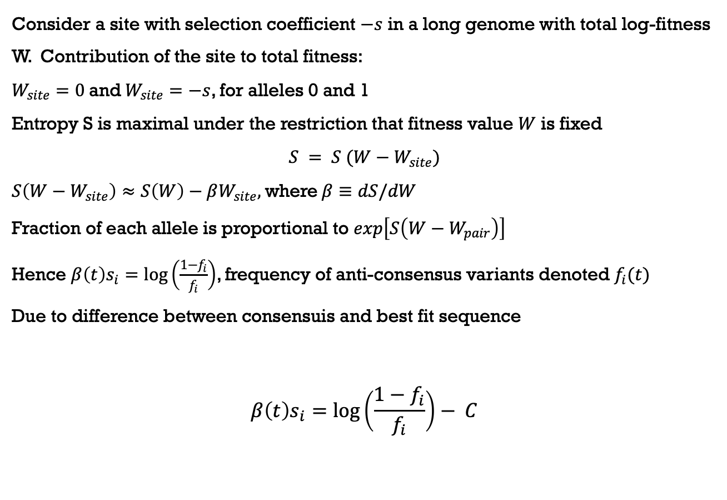
Derivation of the method
Consider a site with selection coefficient $−s$ in a long genome with total log-fitness W. Contribution of the site to total fitness:
$W_{site}=0$and$W_{site}=−s$, for alleles 0 and 1
Entropy S is maximal under the restriction that fitness value $W$ is fixed
$$S = S (W−W_{site})$$
$S\left(W−W_{site}\right)≈S\left(W\right)−βW_{site},$where$β≡dS/dW$
Fraction of each allele is proportional to $exp\left[S\left(W−W_{pair}\right)\right]$
Hence $β\left(t\right)s_{i}=\log\left(\frac{1−f_{i}}{f_{i}}\right)$, frequency of anti-consensus variants denoted $f_{i}(t)$
Due to difference between consensuis and best fit sequence
$$β\left(t\right)s_{i}=\log\left(\frac{1−f_{i}}{f_{i}}\right)− C$$
Barlukova & Rouzine 2018, Likhachev & Rouzine 2023

Slide 5
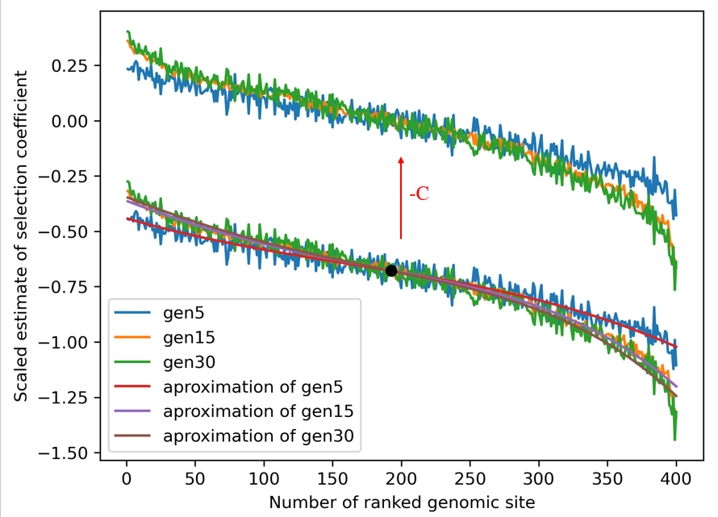
Determining constant C

Slide 6
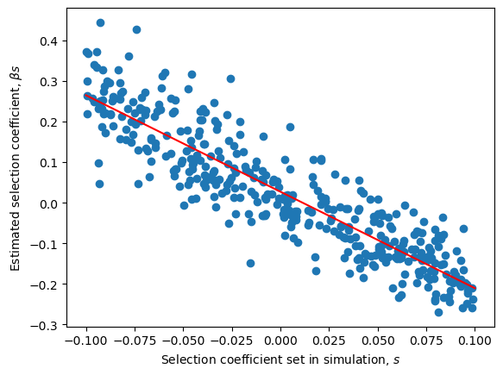
Selection coefficients plotted against their estimates (simulation)

Slide 7
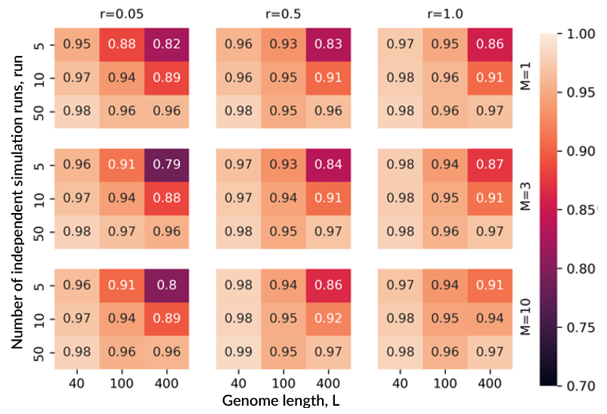
Correlations between the estimated and the actual values of selection coefficient

Slide 8
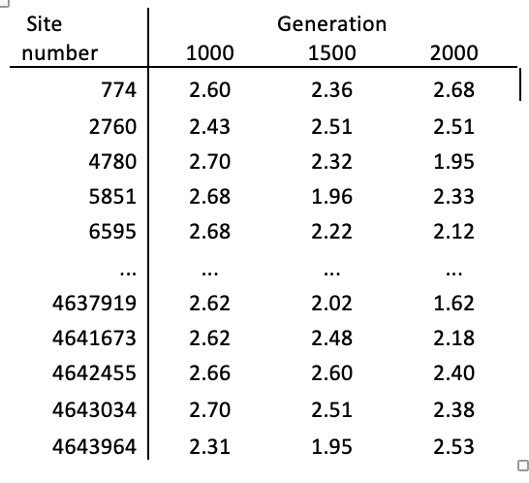
The values of scaled selection coefficient for three chosen generations of E. Coli

Slide 9
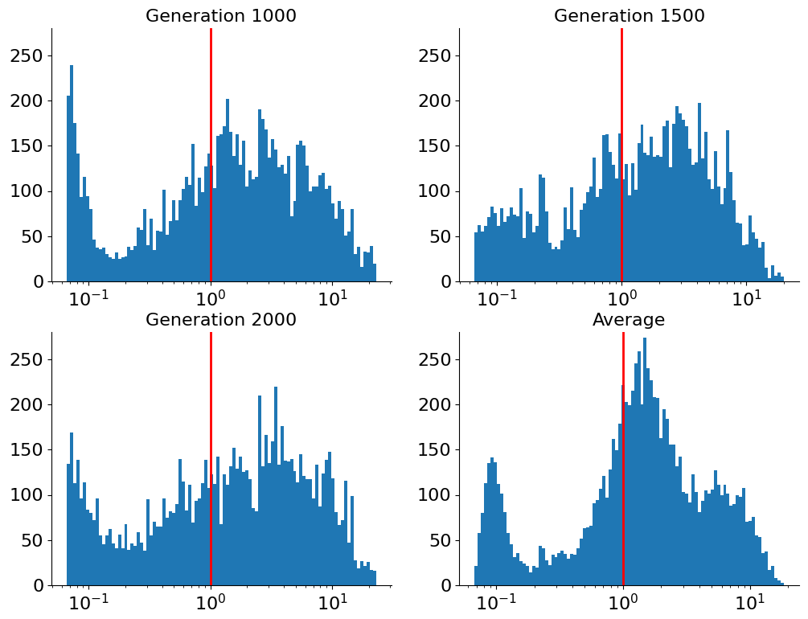
Histogram of fitness effect of mutation

Slide 10
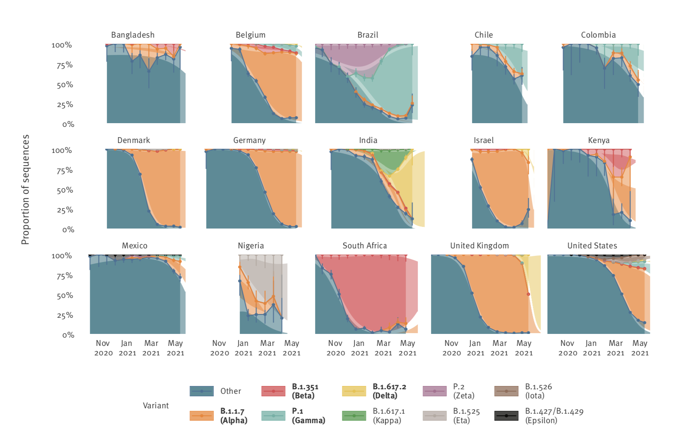
variants of Concern
Volz et al 2021
Davies et al 2021
Graham et al 2021
Campbell et al 2021
Davis et al 2021
Pegu et al 2021
The first 1. 5 years of pandemics:

Slide 11
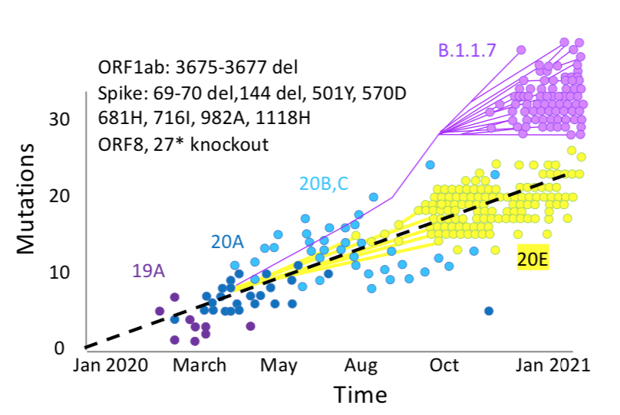

Alpha Strain: Leap in the Number of Mutations
Substitutions
Time
Bedford 2021
https://www.youtube.com/watch?v=Men9WDWvK9E

Slide 12
Why mutations in VOC emerge in large sets?
Reverse zoonosis?
Evolution in unknown parts of population?
Rare chronically infected patients (< 0.5%)? (Leading)

Slide 13
Less studied hypotheses of the origin of VOC of SARS CoV-2
Hypothesis I: Multi-locus recombination
Rouzine 2023
Rejected by Monte Carlo Likachev & Rouzine 2026 (unpublished)

Slide 14
Hypothesis II fitness valley
Rouzine I.M., Viruses 2025

Slide 15
Example from the past: Why HIV evolves so fast
Rouzine & Coffin 1999
A mutation in the epitope allows the virus to escape the immune response, but reduces viral fitness; then compensatory mutations restore it or even increase it higher than initial value

Slide 16
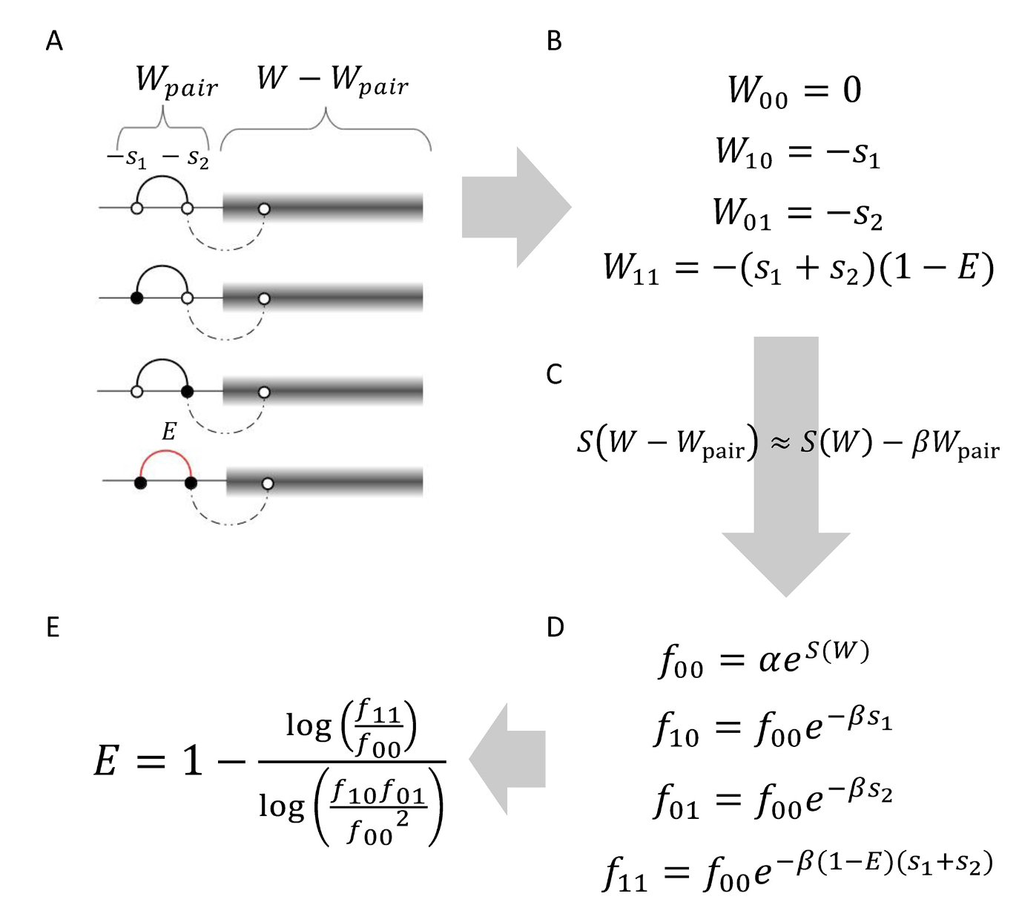
epistasis detection??? Universal footprint of epistasis
Fitness effect
of the 2 sites
Enthropy
Haplotype
frequencies
Pedruzzi, Barlukova, and Rouzine 2018

Slide 17
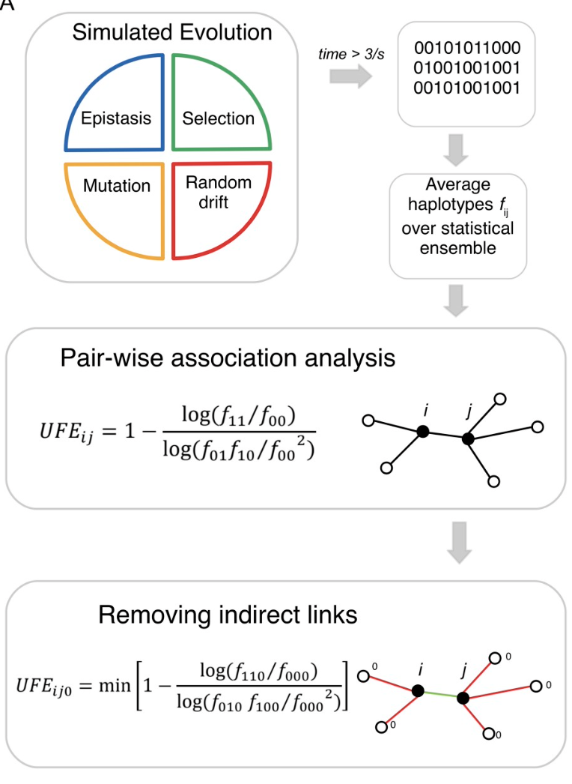
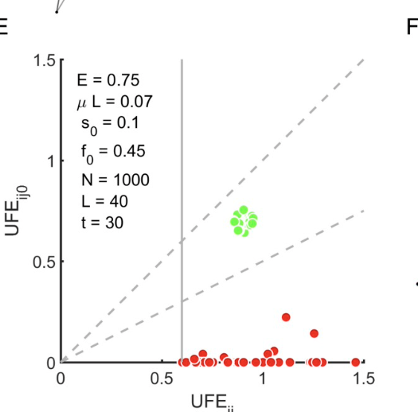
Telling apart epistasis from linkage: averaging over ensemble + 3d locus
Epistasis
Linkage
Pedruzzi and Rouzine 2021

Slide 18
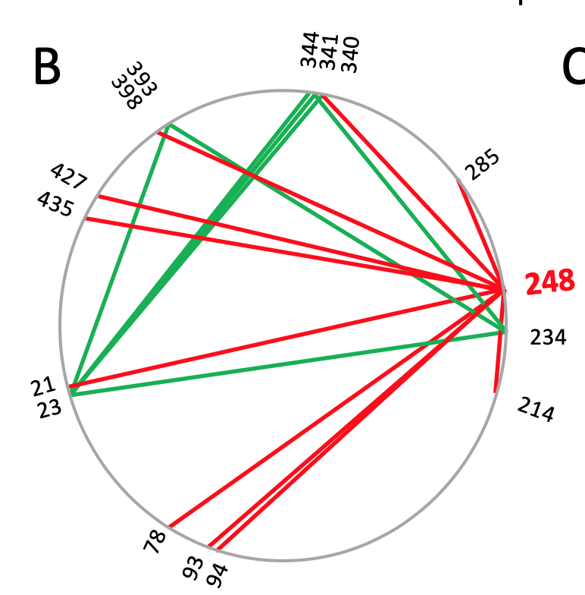
Example 2: Fitness valley for the influenza A virus neurominidase protein, 2009 pandemic
Pedruzzi & Rouzine 2021
Pre- and post-pandemic sequences were mixed, and an epistatic interaction detection method was applied
The primary mutation 248
weakens pH dependence
but "damages" the protein
Secondary and tertiary mutations compensate it

Slide 19
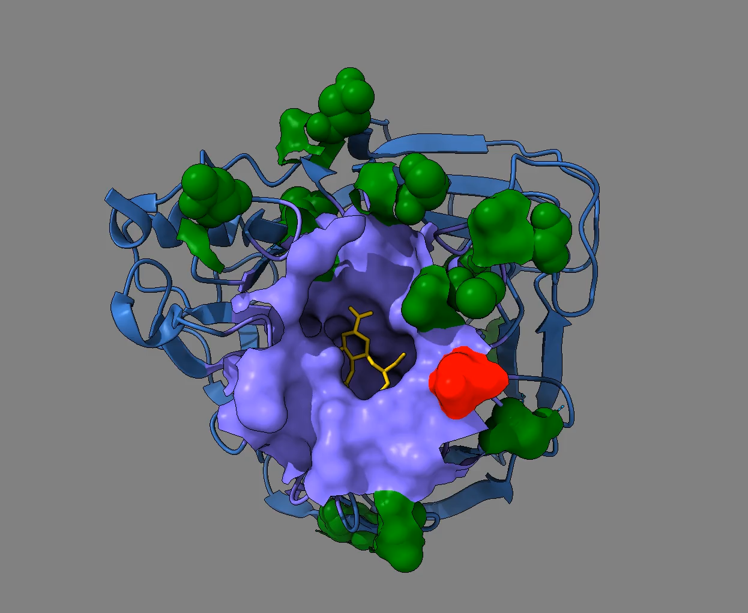
position of predicted compensatory mutations on the structure of neurominidase
Pedruzzi & Rouzine 2021
Primary mutation
Compensatory mutations

Slide 20
Detection of fitness valley for SarS-CoV-2 evolution
Igor Likhachev

Slide 21
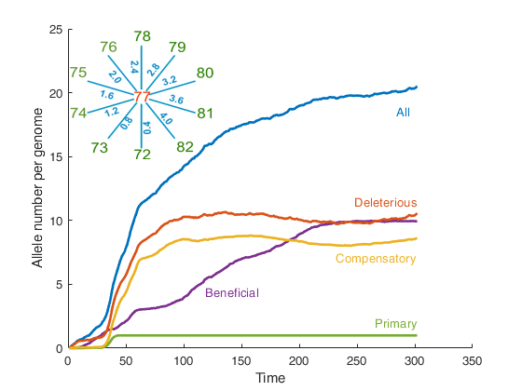
Spontaneous crossing of a fitness valley (Simulation)
Likachev & Rouzine 2026 (preprint)
All
Mutation number
Deleterious
Compensatory
Beneficial
Primary
Time, generations

Slide 22
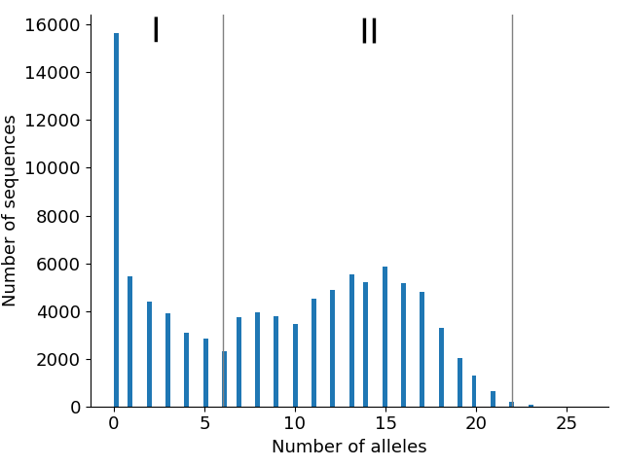
Mutation spectrum (simulation)
Number of sequences
Number of substitutions

Slide 23
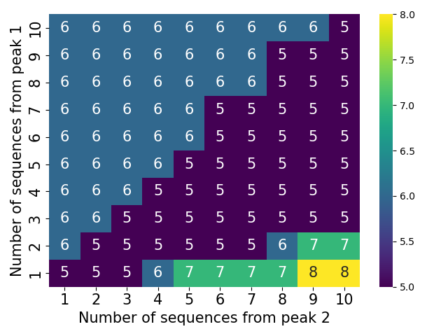
Epistasis detection error by the upgraded method
Based on Pedruzzi & Rouzine 2021
The number of missed connections out of 10. There are no false positives.
Число последовательностей пика 1
Number of peak sequences 2

Slide 24
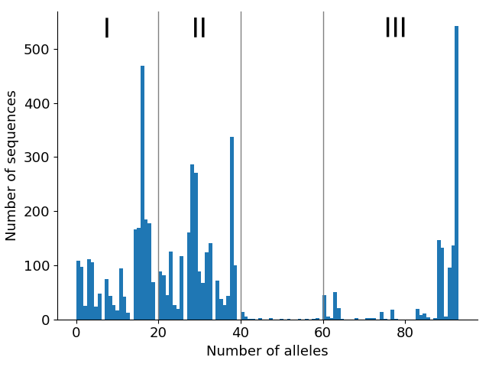
Mutation spectrum of SARS-CoV-2
6000 sequences from 6 regions, 1000 from each: Africa, Asia, North America, Oceania, South America, for the period from 09/24/2020 to 09/25/2021.
Number of sequences
Number of substitutions
Mix

Slide 25
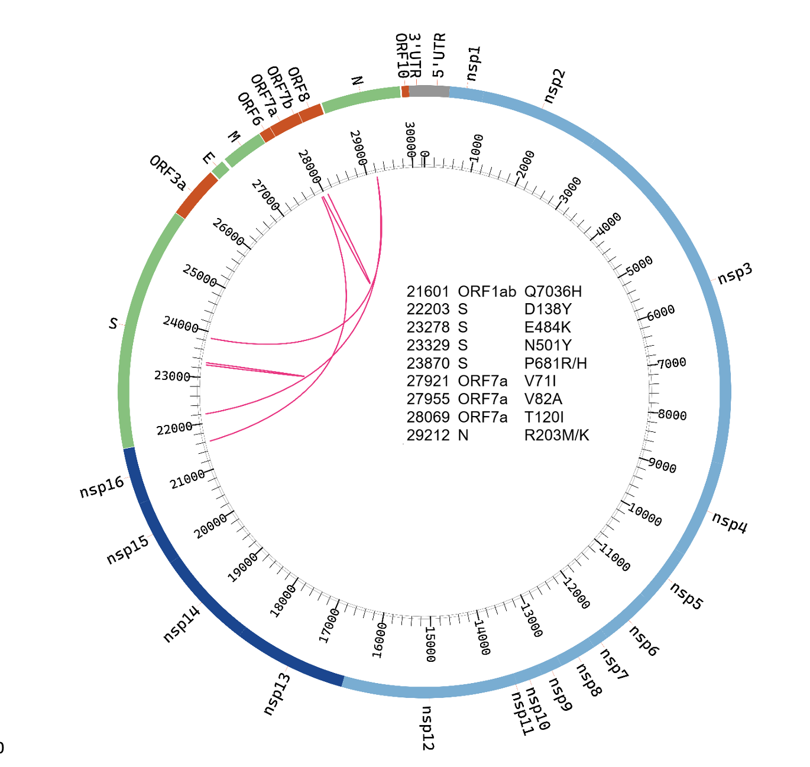
Epistasis Discovered in the SARS-CoV-2 Genome
Likachev & Rouzine 2026

Slide 26
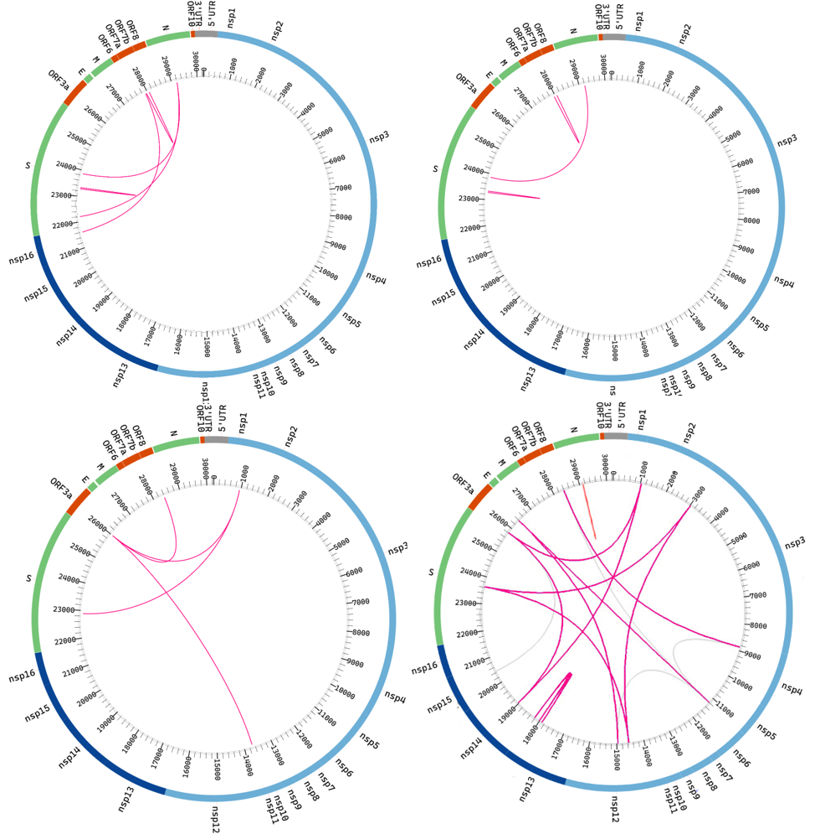
Comparison with other methods
Likhachev & Rouzine 2026
These methods have not been tested
on simulated evolution.
Zeng … Aurell, 2020
Rodriguez-Rivas… Weigt 2022

Slide 27
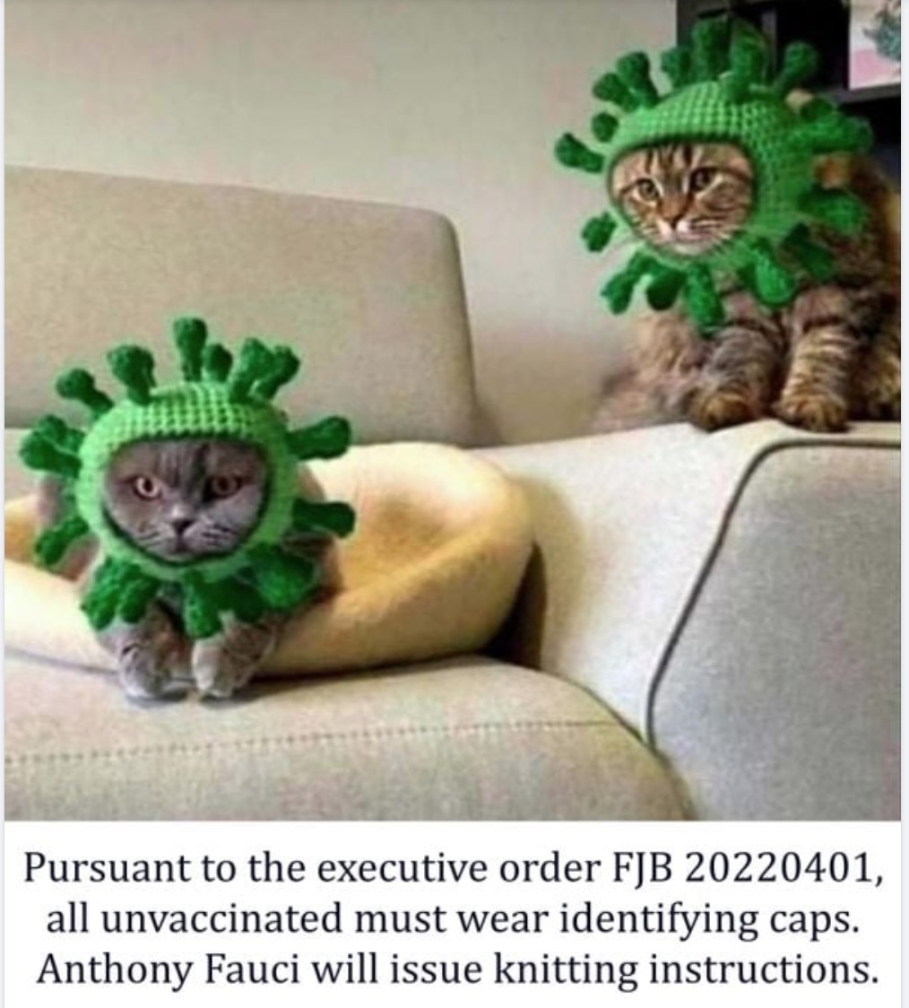
Thank you! Grazie! Gracias! Merci! DanKe! Спасибо! Շնորհակալություն!

